Slide 1
OSSEC
A Host-Based Intrusion Detection System
CSE 406 - Security Tools
Section: A1
Group: 2
Topic ID: 8
IDs: 1705007, 1705008 ,1705009
1705010, 1705011, 1605021

Slide 2
General Overview
An intrusion detection system is a device or software application that monitors a network or systems for malicious activity or policy violations.
A HIDS(Host-based Intrusion Detection System) detects events on a server or workstation and can generate alerts.
OSSEC is a scalable, multiplatform, open source HIDS.

Slide 3
General Overview
Features
Powerful correlation and analysis engine
Log analysis integration
File integrity checking
Windows registry monitoring
Centralized policy enforcement
Rootkit detection
Real-time alerting
Active response

Slide 4
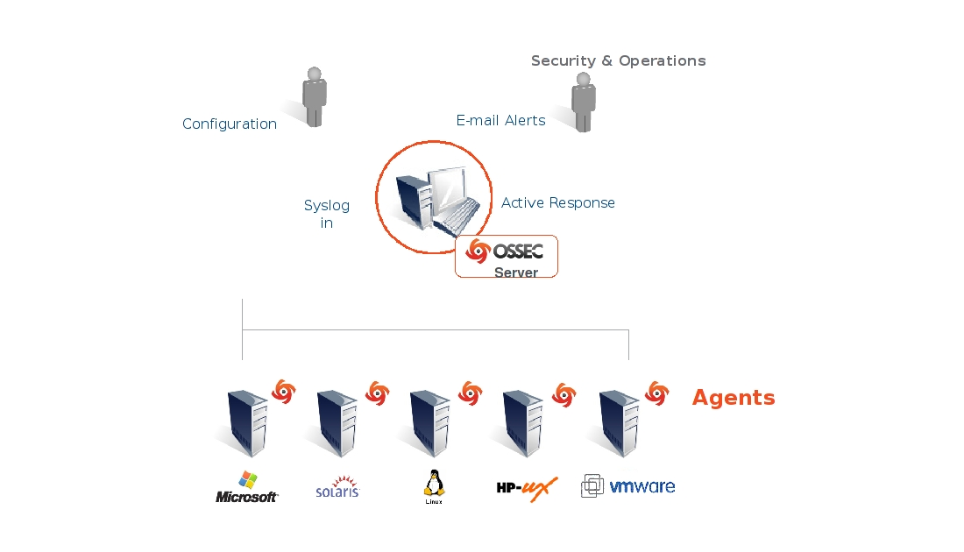
OSSEC Architecture
Notes:
https://www.ossec.net/docs/_images/ossec-arch.jpg

Slide 5
OSSEC Architecture
Components
Web interface
Manager or Server
Agent
Agentless mode
Can be installed on
Normal PC/Server
Virtualization/VMware
Firewalls, Switches, Routers
Notes:
https://www.ossec.net/docs/_images/ossec-arch.jpg

Slide 6
Log Monitoring

Slide 7
Log Monitoring
Sometimes logging is the only record or evidence of a successful attack. Without solid logs, an attack may go undetected, and damage can be ongoing for months, if not years
Log Analysis (or log inspection) is done inside OSSEC by the logcollector and analysisd processes.

Slide 8
Log Monitoring
Logcollector : collects the events
Analysisd processes : analyzes (decodes, filters and classifies) the collected events.
Real Time
Can read events from
Internal log files
Windows event log

Slide 9
Log Analysis
Inside OSSEC the log analysis part is called LIDS, or log-based intrusion detection.
Goal : Using the logs, detect -
Attacks
Misuse
System errors

Slide 10
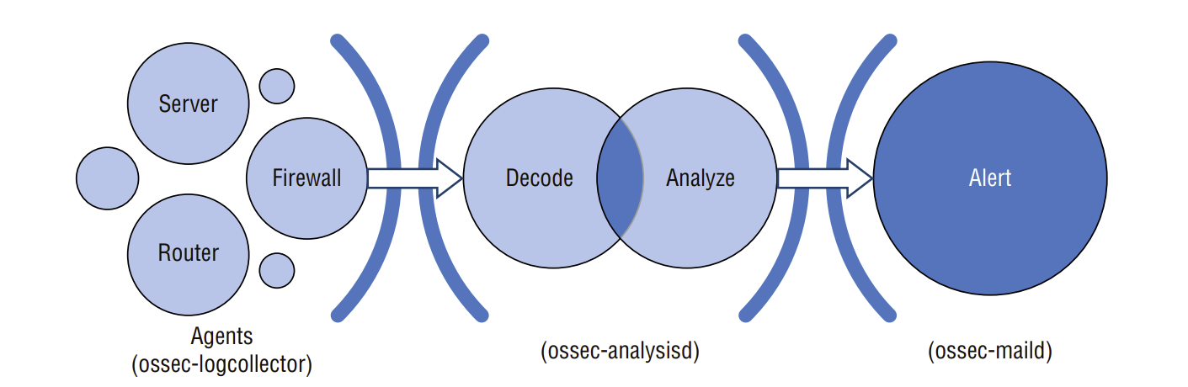
Log-based Intrusion Detection System (LIDS)

Slide 11
Log Monitoring Methods
Two major methods for monitoring logs:
File
Process
Process Monitoring : allows you to monitor the output of any command and generate alerts/active responses from them
File Monitoring : ossec-logcollector monitors the configured log files for new events. When new log messages arrive, it forwards them to other processes for analysis or transport to an OSSEC server

Slide 12
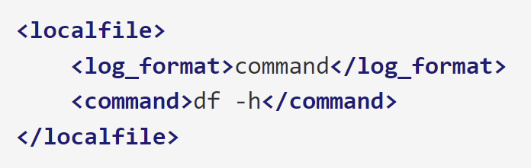
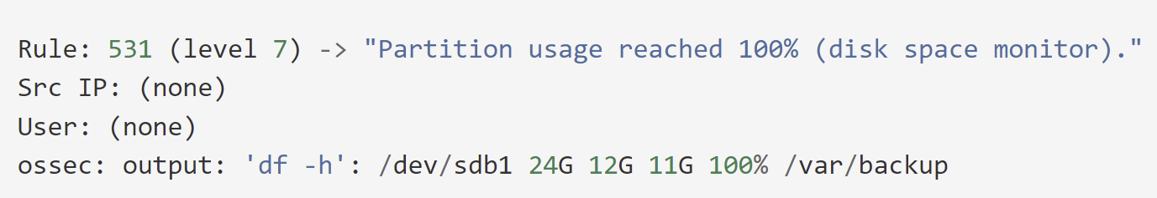
Example 1
/var/ossec/etc/ossec.conf
Disk space utilization (df -h)
output

Slide 13
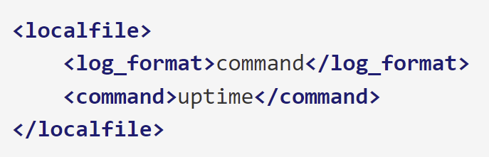
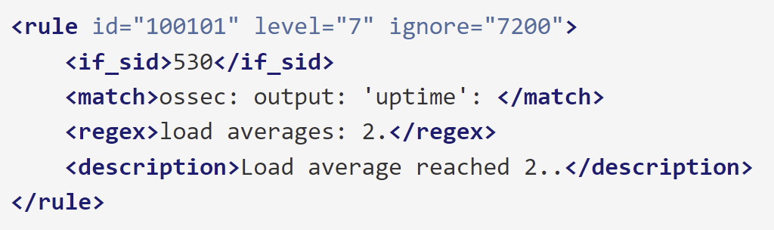
Example 2
/var/ossec/etc/ossec.conf
/var/ossec/rules/local_rules.xml
Load average (uptime) monitoring

Slide 14
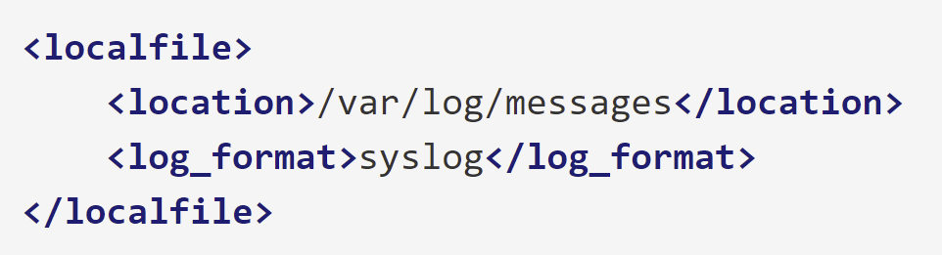
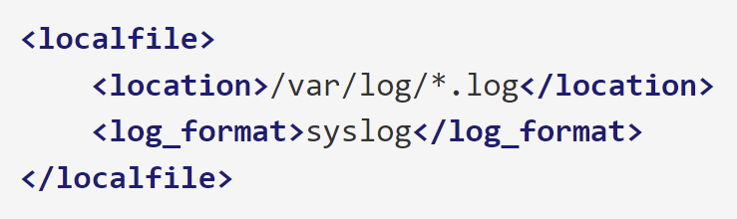
Example 3
/var/ossec/etc/ossec.conf [Single File]
/var/ossec/etc/ossec.conf [Multiple Files]
Log File Monitoring

Slide 15
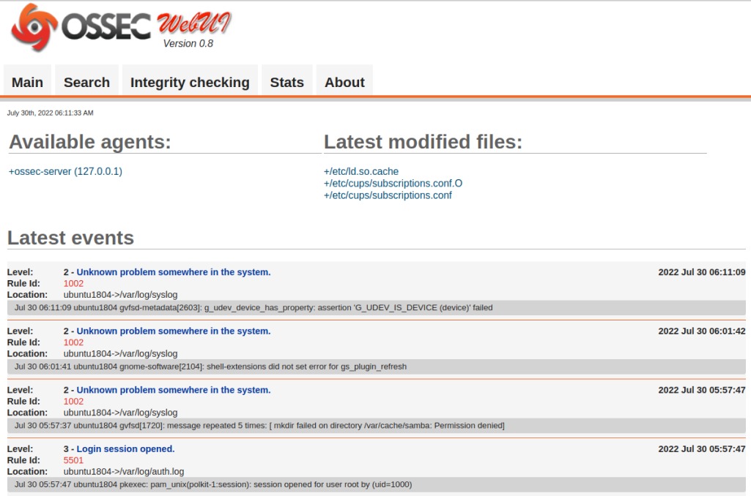
Log Monitoring Demo

Slide 16
Rootkit Detection

Slide 17
Rootkit
A set of programs and code
Allows a permanent and undetectable presence on a computer
Example: shv5
Notes:
https://citeseerx.ist.psu.edu/viewdoc/download?doi=10.1.1.741.5264&rep=rep1&type=pdf

Slide 18
Rootcheck: Rootkit Detection Engine
Performs rootkit detection on every agent
Rootcheck runs at every X minutes specified by the user
Checks
Read the rootkit_files.txt : Common rootkit files
Read the rootkit_trojans.txt : Common trojan signatures
Scan the /dev directory looking for anomalies
Scan the whole filesystem looking for unusual files and permission problems
Look for the presence of hidden processes
Look for the presence of hidden ports
Scan all interfaces on the system and look for the ones with “promisc” mode enabled
Notes:
https://www.ossec.net/docs/docs/manual/rootcheck/manual-rootcheck.html#checks-that-rootcheck-performs

Slide 19
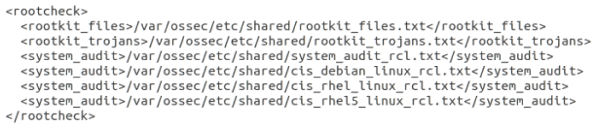
Rootcheck Configuration

Slide 20
Example
Robust partition scheme: “...” not in own partition
Trojaned version of ‘grep’
shv5 Rootkit

Slide 21
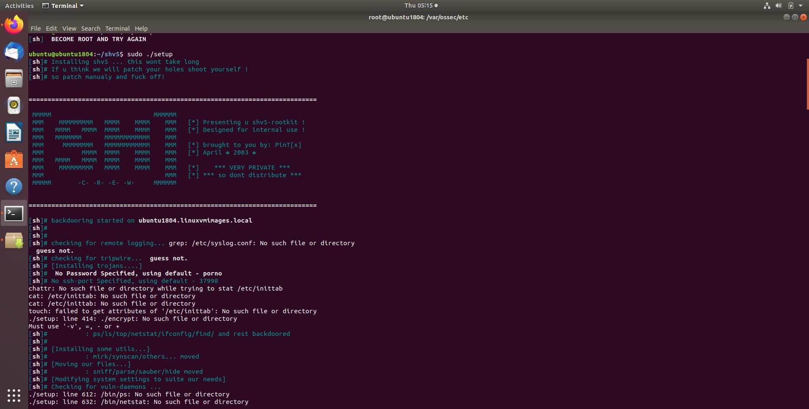
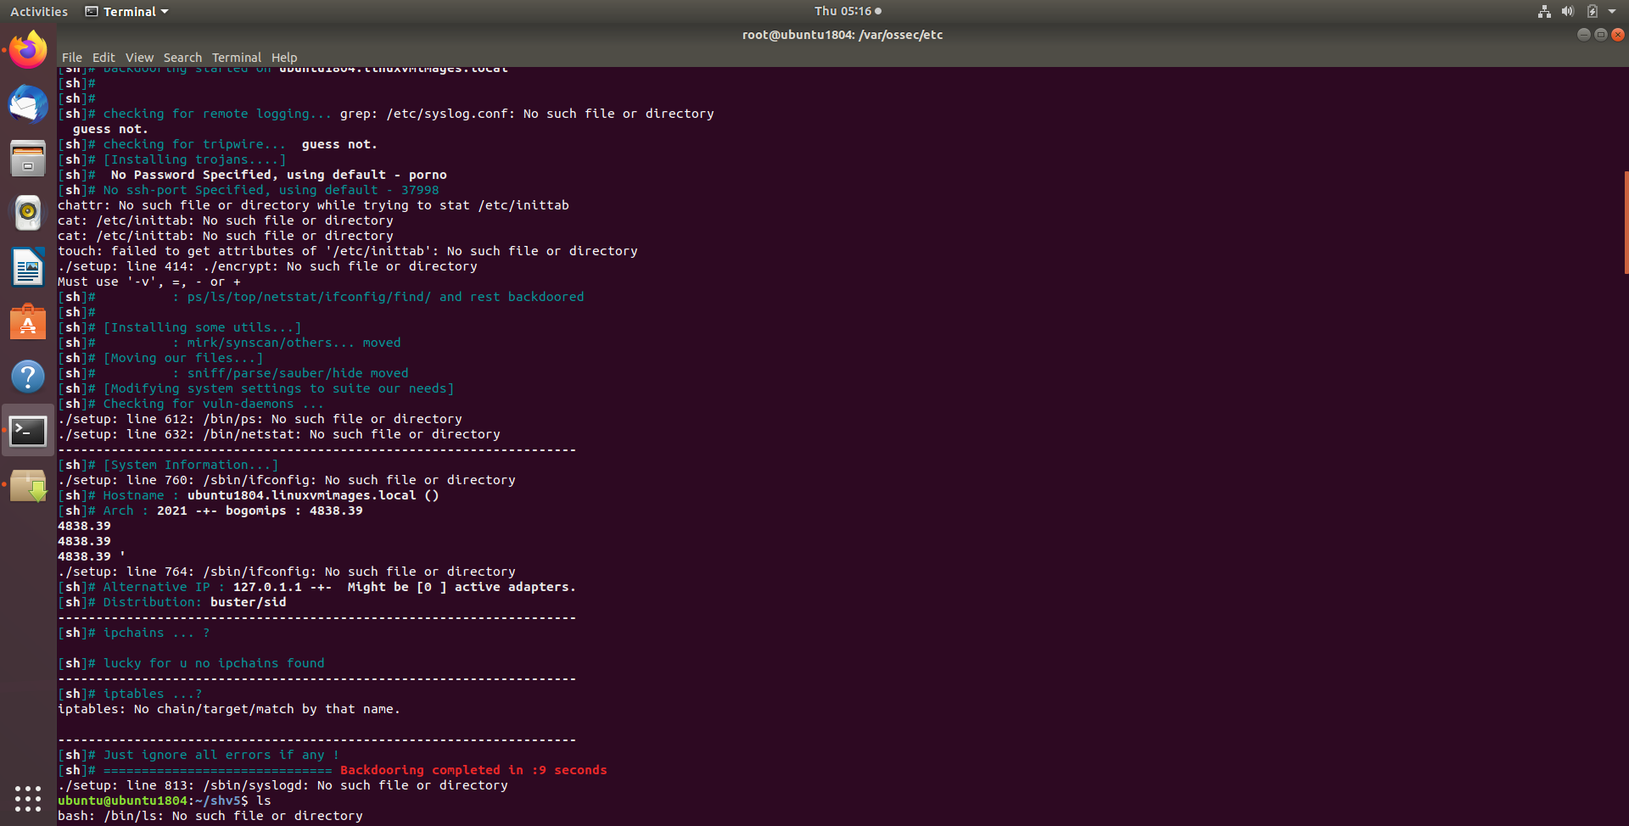
shv5 Rootkit: Setup as root

Slide 22
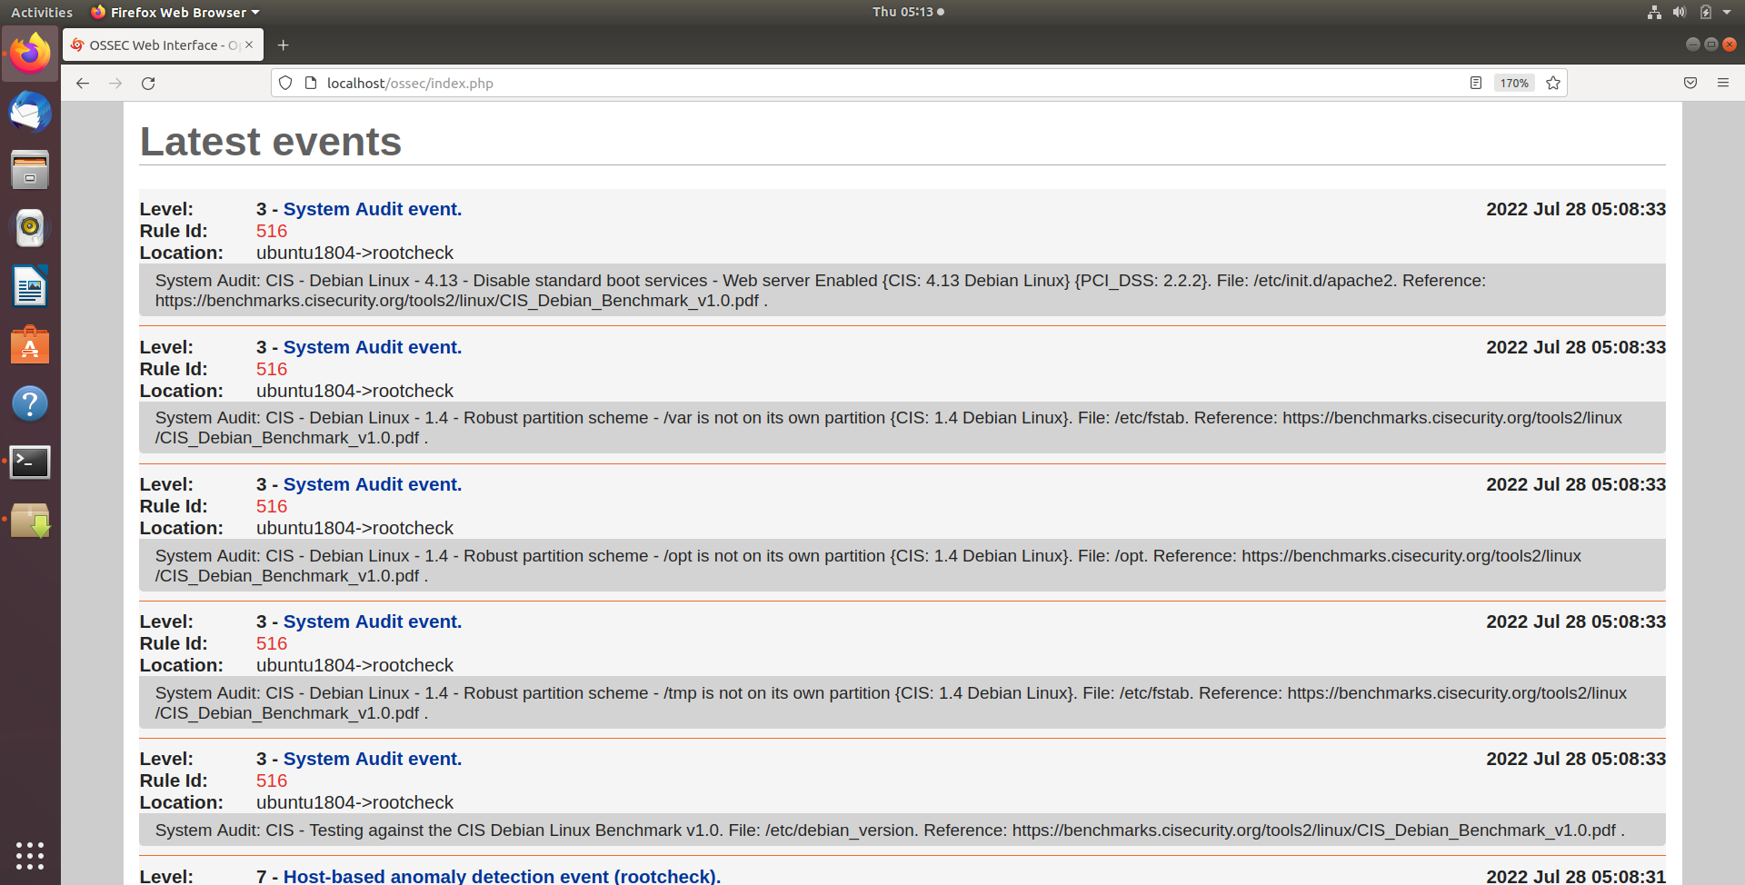
shv5 Rootkit: Detected by Rootcheck

Slide 23
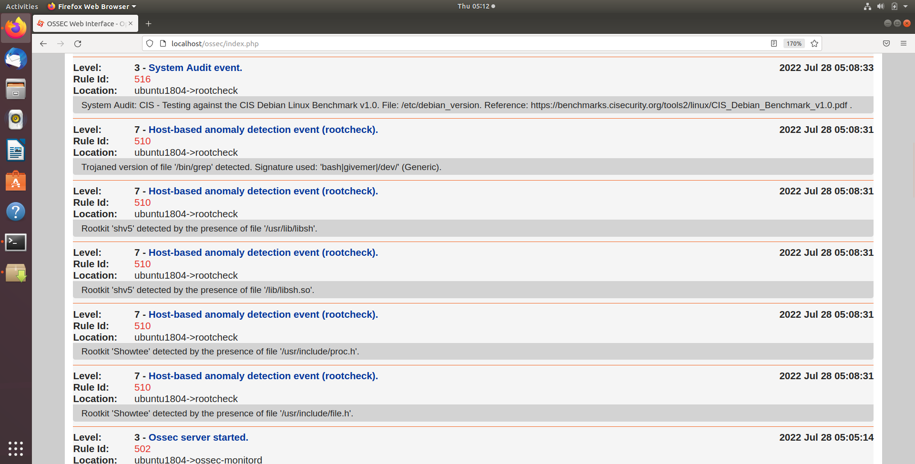
shv5 Rootkit: Detected by Rootcheck

Slide 24
File Integrity Checking

Slide 25
File Integrity Checking
There are multiple types of attacks and many attack vectors, but there is one thing unique about all of them: they leave traces and always change the system in some way. From viruses that modify a few files, to kernel-level rootkits that alters the kernel, there is always some change in the integrity of the system.
Integrity checking is an essential part of intrusion detection, that detects changes in the integrity of the system. OSSEC does that by looking for changes in the MD5/SHA1 checksums of the key files in the system and on the Windows registry.

Slide 26
File Integrity Checking
Syscheck is the name of the integrity checking process inside OSSEC.
It runs periodically to check if any configured file (or registry entry on Windows) has changed.
The way it works is that the agent scans the system every few hours (user defined) and send all the checksums to the server. The server stores the checksums and look for modifications on them. An alert is sent if anything changes.

Slide 27
File Integrity Checking
How often does it run?
By default every 6 hours, but the frequency or time/day are configurable.
Where is the database stored?
On the manager in /var/ossec/queue/syscheck.
How much CPU does it use?
The scans are performed slowly to avoid using too much CPU/memory.
How are false positives handled?
Files can be ignored manually in the configuration or using rules. By default when a file has changed 3 times further changes are automatically ignored.

Slide 28
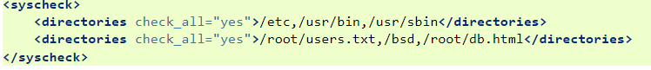
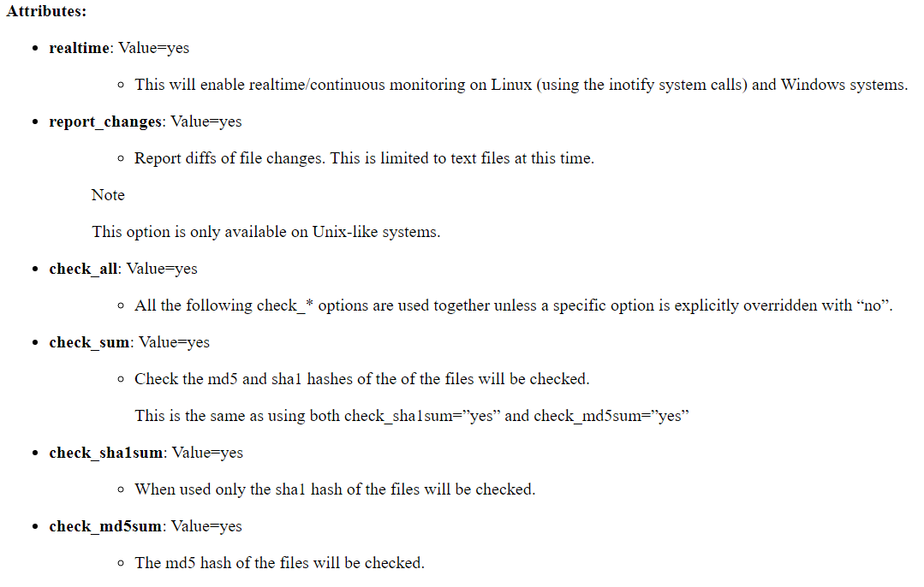
File Integrity Checking : Directories

Slide 29
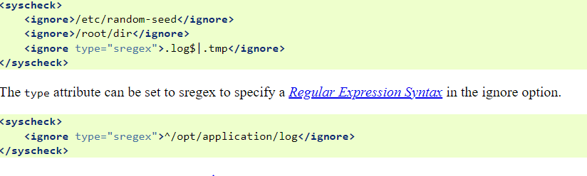
File Integrity Checking : Ignore Files

Slide 30
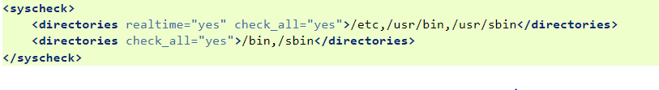
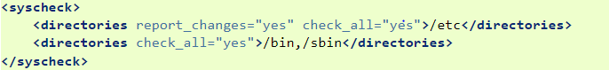
File Integrity Checking
Real Time Monitoring
Report Changes

Slide 31
Active Response

Slide 32
Active Response
OSSEC provides automated remediation to security violations and threats
It can run script when certain criteria met to block specific hosts and/or services so that a detected violation can be stopped or contained and controlled
Remedial actions can be:
Firewall block or drop
Quarantine
Traffic shaping or throttling
Account lockout

Slide 33
Included Scripts for Active Response
disable-account.sh : Disables an account for logins on most Unix-like operating systems.
host-deny.sh : Adds hosts to the /etc/hosts.deny file used by tcpwrappers. This is only useful for services with tcpwrappers enabled.
route-null.sh : Adds an IP address to the reject or blackhole list. This is similar to firewall-drop.sh, except it is only useful on hosts that forward packets between networks, such as a router, and it does not use the packet filtering code in the kernel.

Slide 34
Included Scripts for Active Response
firewall-drop.sh : A universal firewall response script that should work with common Linux/Unix operating systems.
ipfw_mac.sh : A firewall-drop response script created for the Mac OS X firewall.
ipfw.sh : A firewall-drop response script created for ipfw, the FreeBSD IP packet filter.
pf.sh : A firewall-drop response script created for pf, the BSD licensed stateful packet filter.

Slide 35
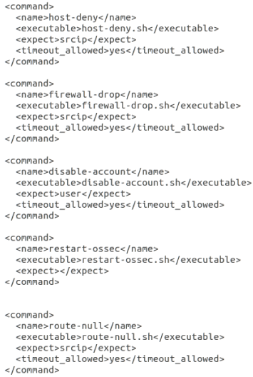
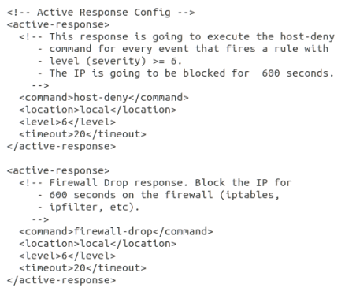
Example Command and Rules

Slide 36
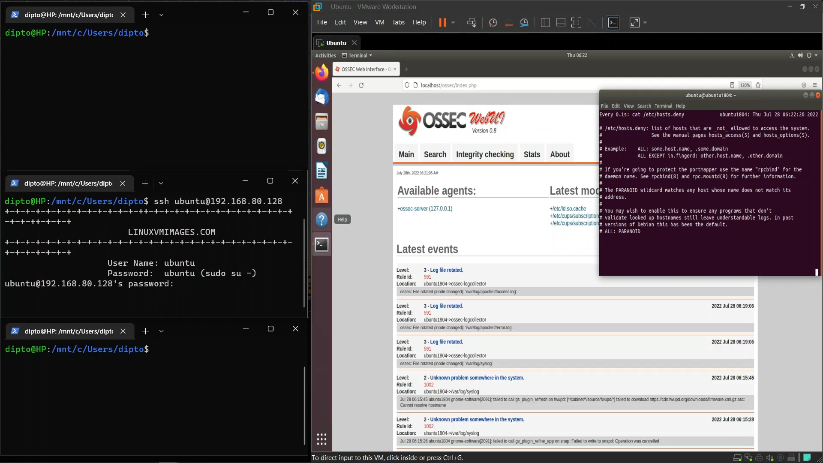
Active Response: Demo (IP not blocked)

Slide 37
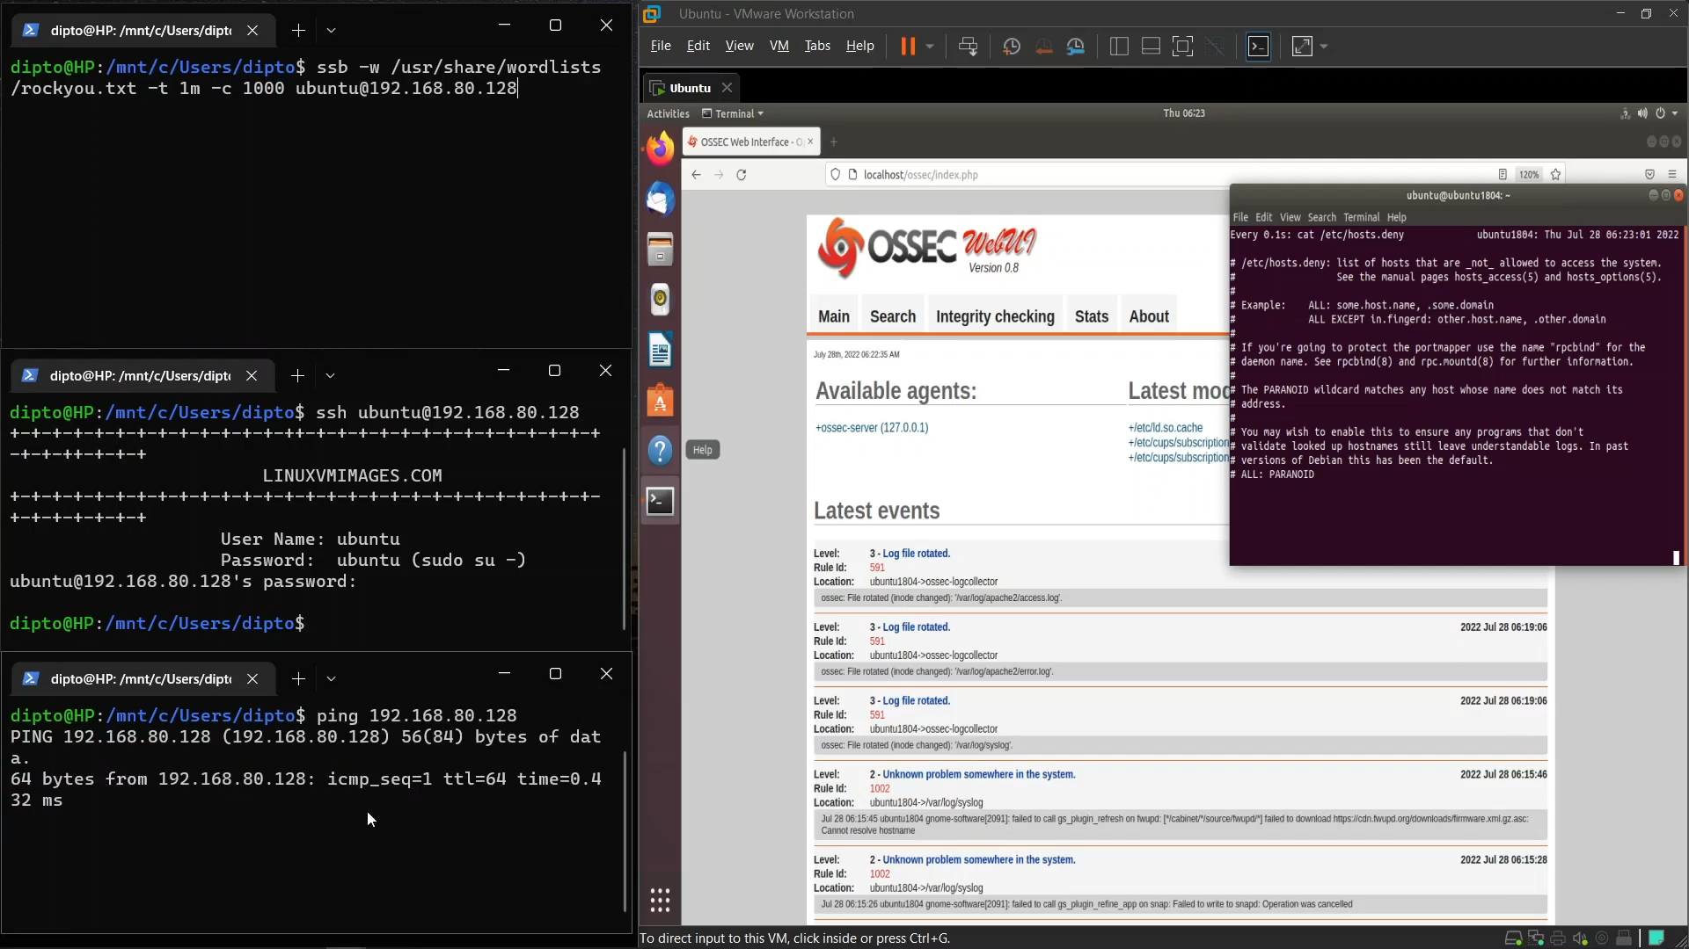
Ping is working (IP not blocked)

Slide 38
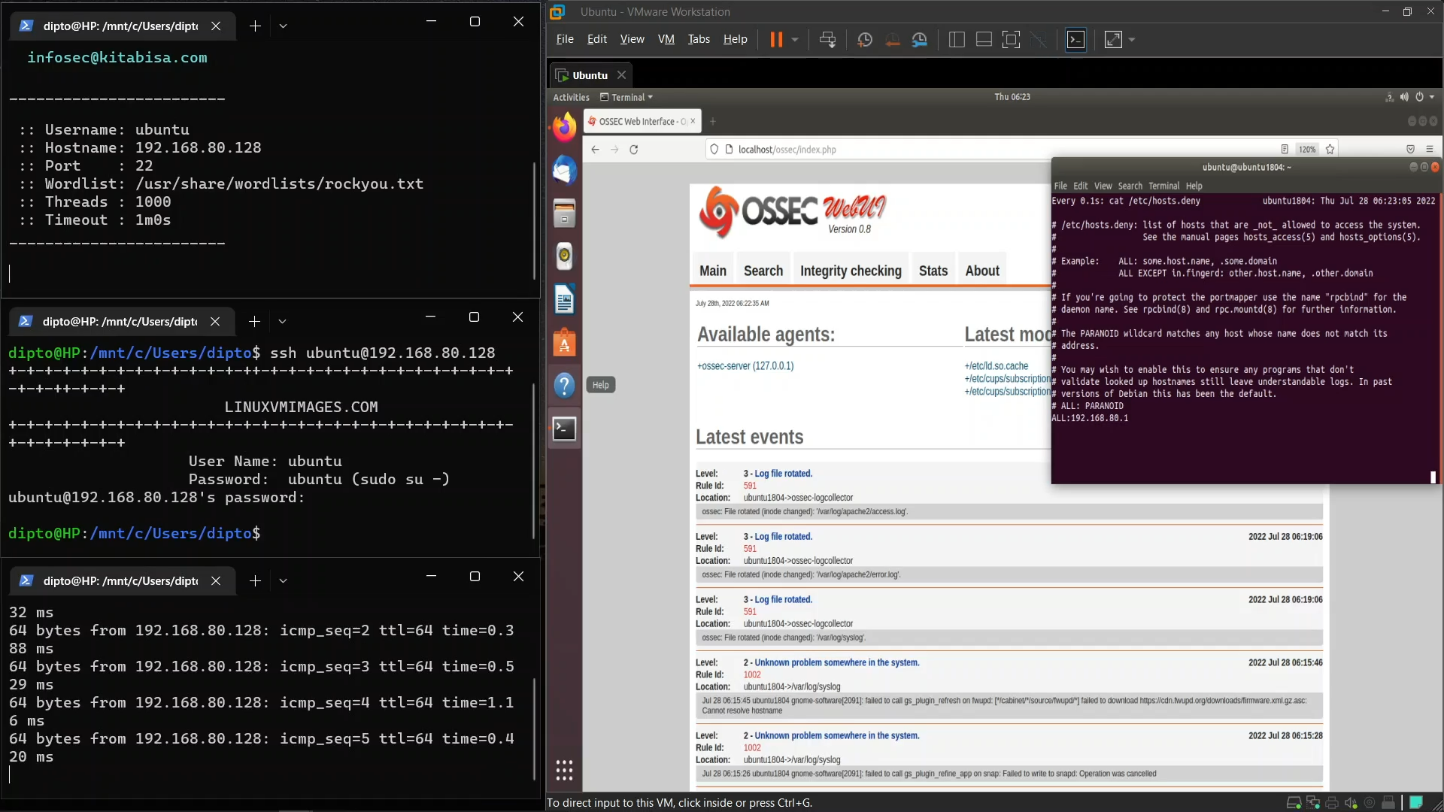
IP is in /etc/hosts.deny (ping not working)

Slide 39
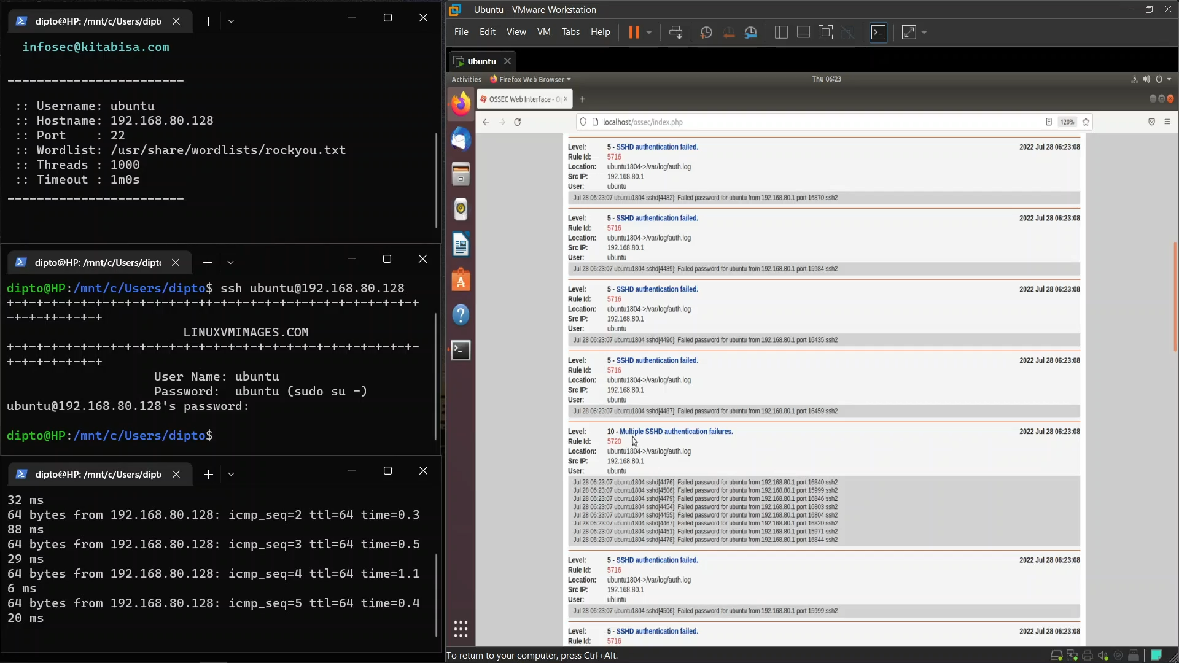
Attack attempt reported in log

Slide 40
TODO: Add GIF Video

Slide 41
Limitations of OSSEC

Slide 42
Limitations
No capability to analyze network traffic. Hence, falls short in analyzing wired or wireless network intrusions.
Only analyzes clear text log files. So, binary log files are not decoded.
Machine learning ?
Advanced Protection ?
Notes:
Taken from the paper

Slide 43
Thank You

